Slide 1
TinyBoy Project A 3D Printer for Education / STEM
Makeomnia

Slide 2
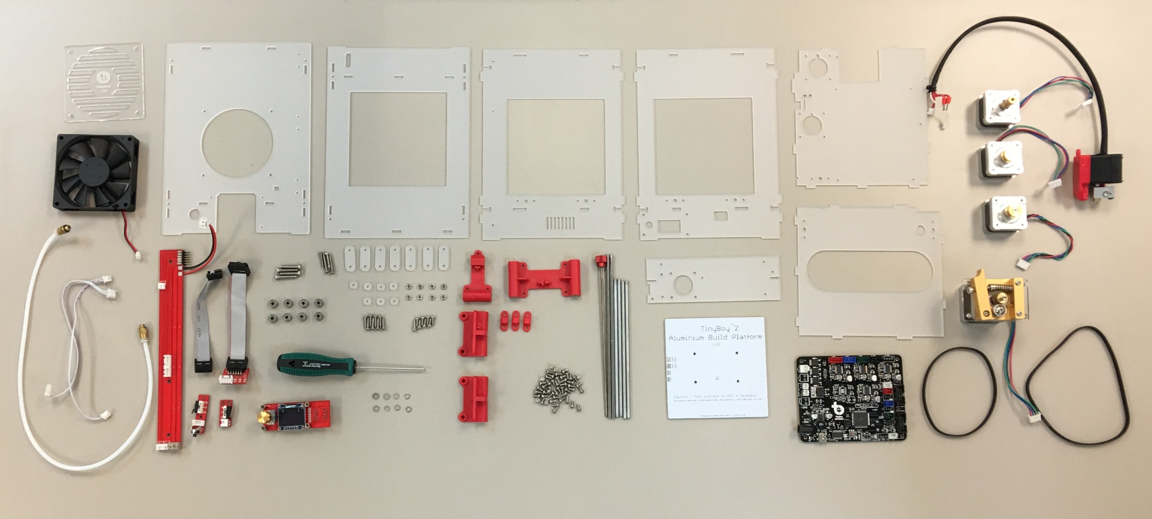

Slide 3
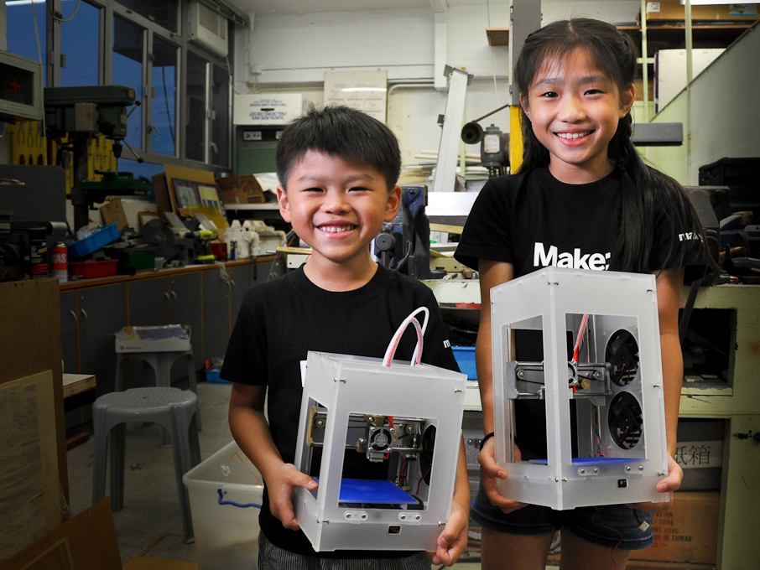

Slide 4
Background
Started by Parker Leung, a D&T school teacher in 2011
The First public demo was shown at COSCUP, Taiwan, 2013
the First prize of the Innovation of the Best Teaching tools of the 29th China Adolescents Science & Technology Innovation Contest, 2014

Slide 5
Background
the Best Innovation (Innovative Technology) Bronze Award of the Hong Kong ICT Awards 2015
Founded a new startup at 2015
Cyberport incubatee since 2015
Cloud-funding successfully for 2nd Version on Indiegogo at Nov 2015
Our Early Bird Backer orders will be shipped out at the end of April

Slide 6
Aim
To promote the maker culture and creative commons
1:1 ratio to maximize the exposure of student to 3D printing technology
To transform education by inviting students to go beyond being consumers of education (STEM/STEAM)
To engage in their learning activities and self-directed learning by making

Slide 7
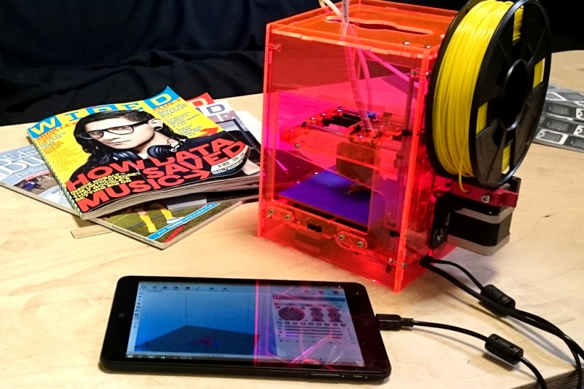
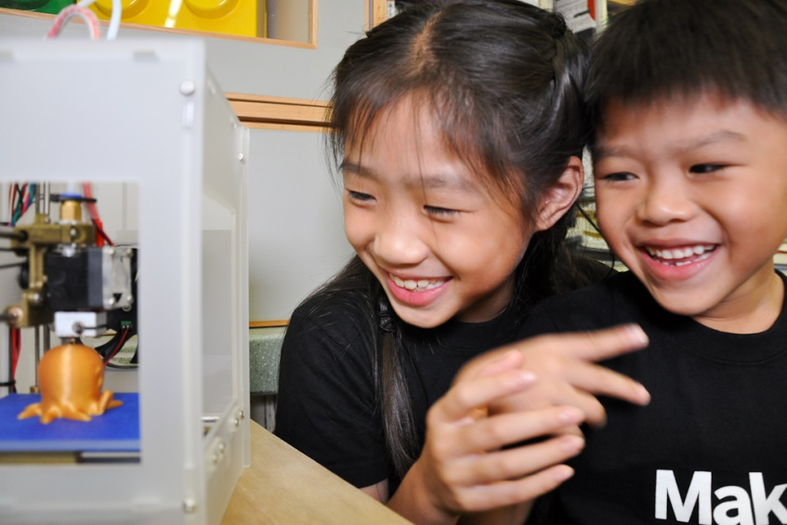
TinyBoy 2
Ultra portable, Simple
Open Design
Easy to operate and maintain
High printing quality and CP rate

Slide 8
TinyBoy 2
Arduino Mega 2560
Planning to use Raspberry Pi 3 as Host
Print server
Simple 3D model editor
3D models share platform

Slide 9
Cloud Platform
3D model sharing
Remote Printing
BlocksCAD
w/ library
Slicer
Raspberry Pi 3
Print
Server
Bundle inside TinyBoy 3 /
upgrade box for TinyBoy 2
Wifi (Web service)
i2c
Client PC / Tablet
Atmega 2560
(Arduino + Marlin Firmware)
spi
128 * 64
OLED
USB
gpio
Stepper Drivers / NTC sensor / PWM Heater
Current TinyBoy 2 L10 / L16

Slide 10
STEM Education Program
TinyBoy +
Arduino +
App Inventor +
Cloud Platform
Robotics
IOT + Mobile App
Interactive Design
Online Learning

Slide 11
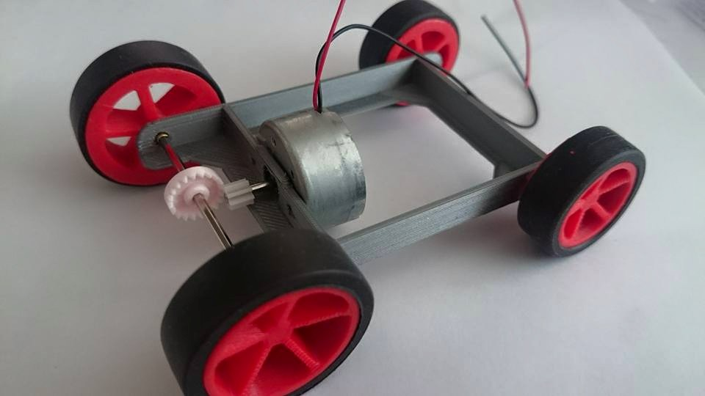
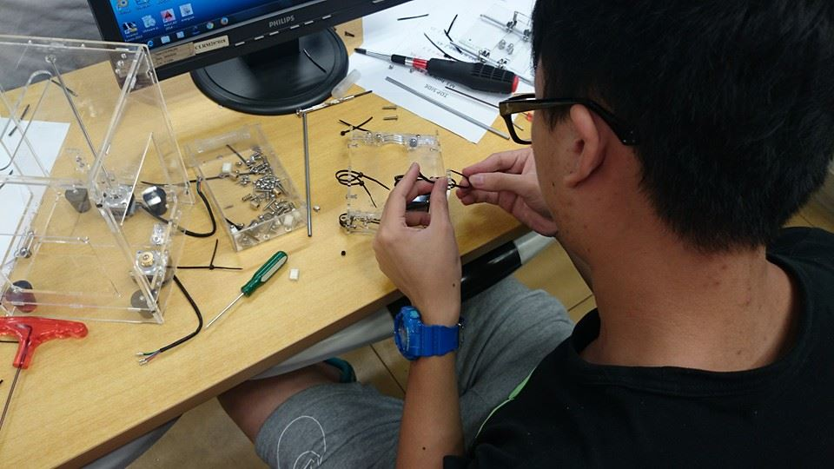
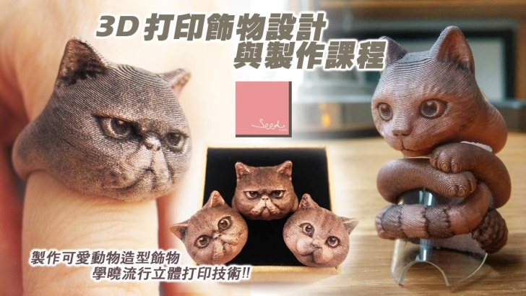
Coding
Arduino + S4A
App Inventor
Engineer-ing
CAD Design
Mechanic + Robotics
Techno-logy
Electronics + Sensors
Intro of Edge Technology
Art
3D modeling and animation
IOT +Database
Architecture + Structure
Interactive Art
Product Design

Slide 12
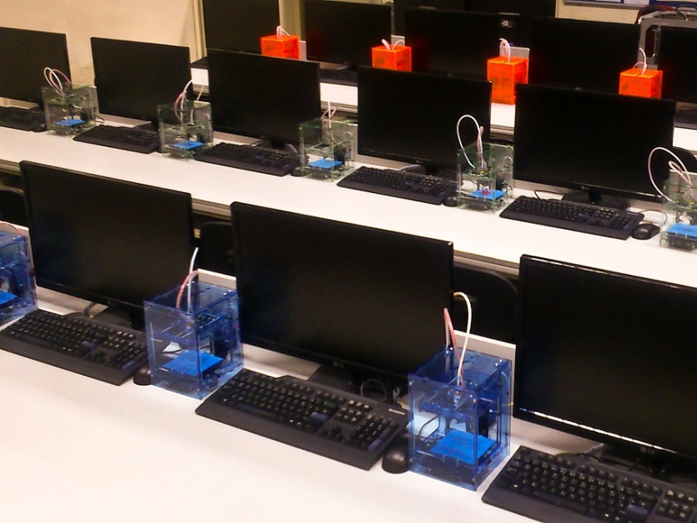

Slide 13
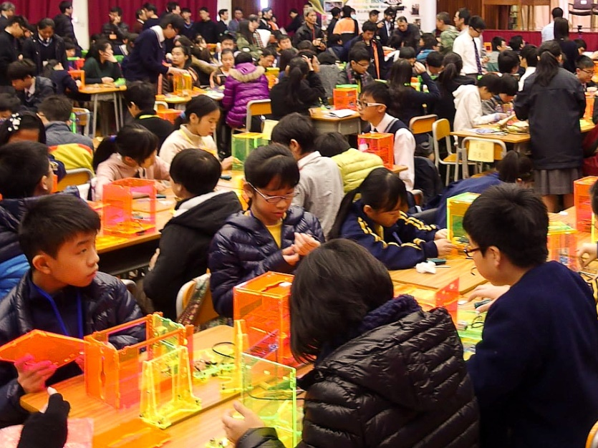

Slide 14
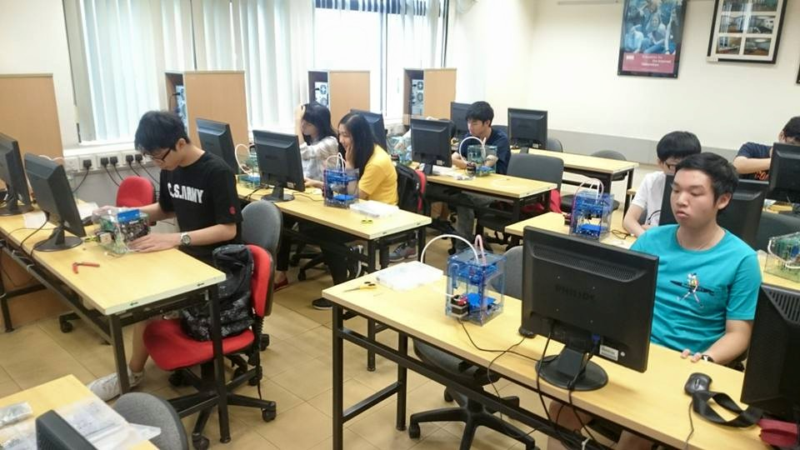
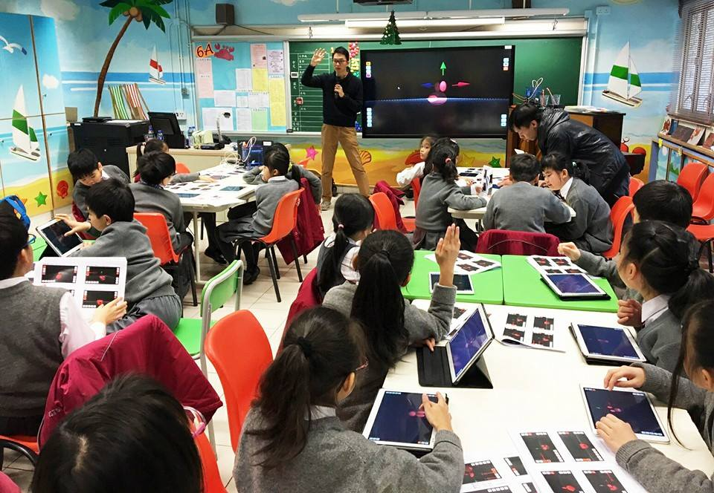
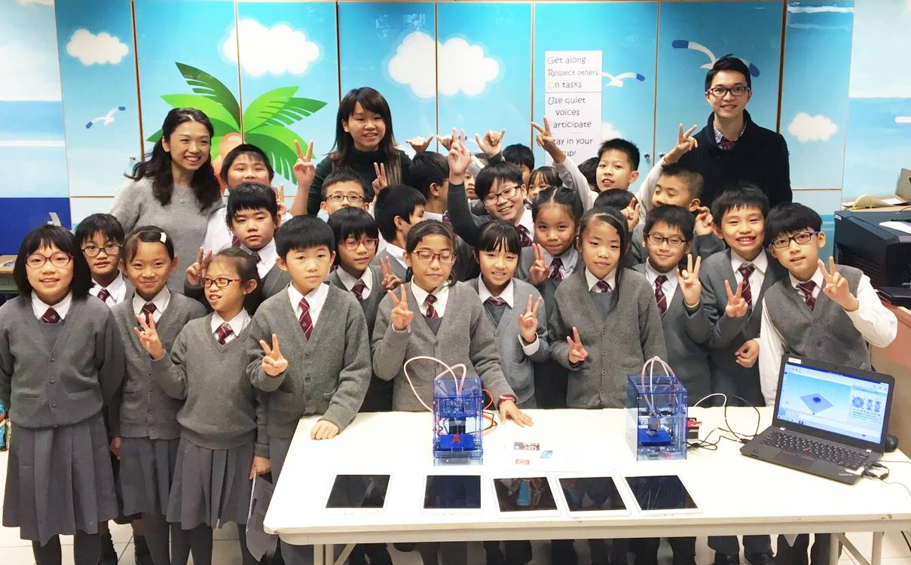
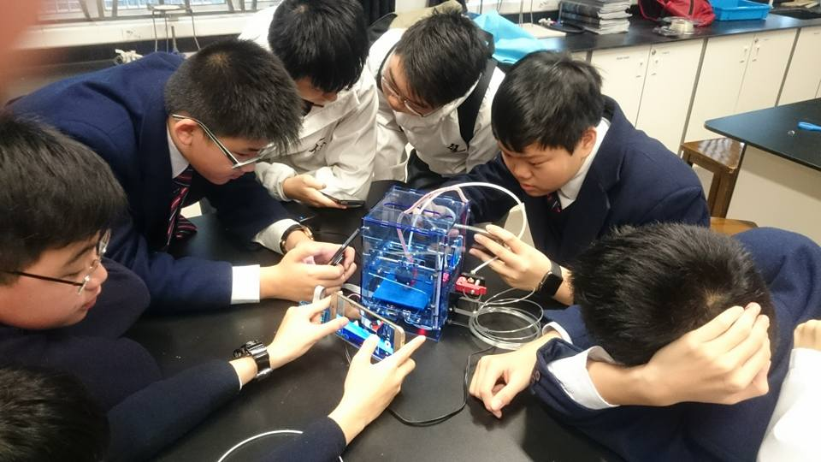

Slide 15
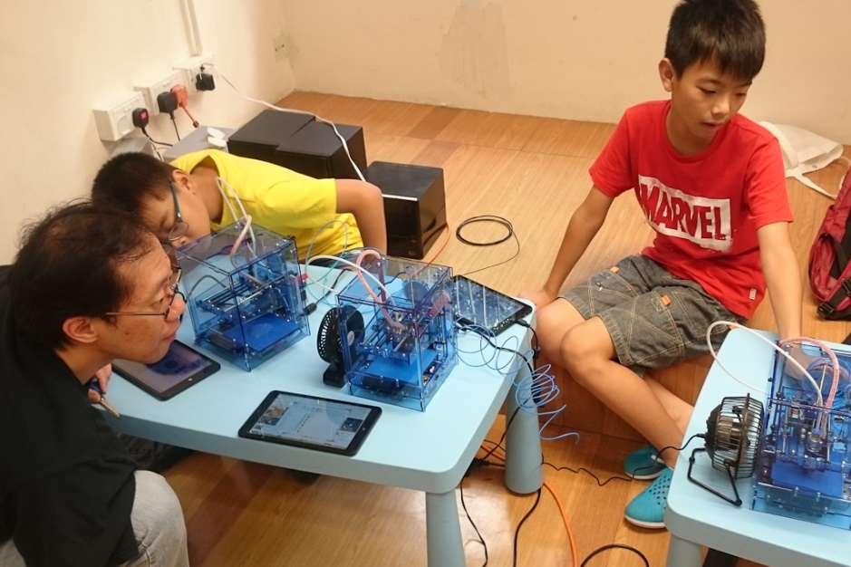
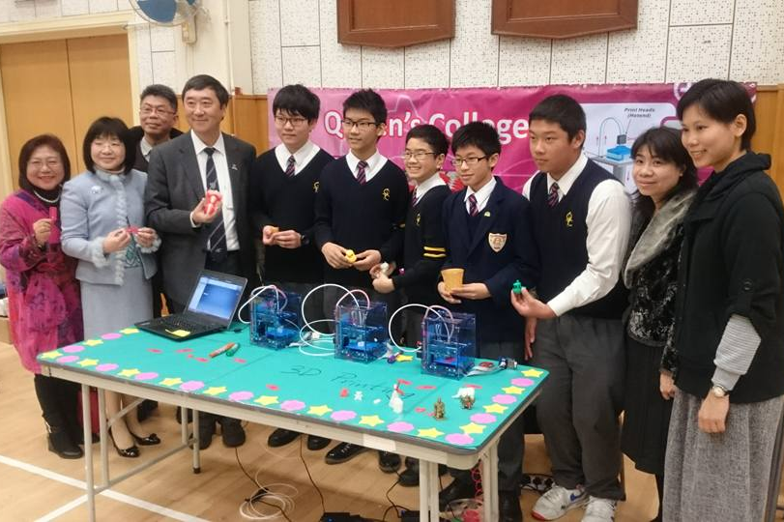
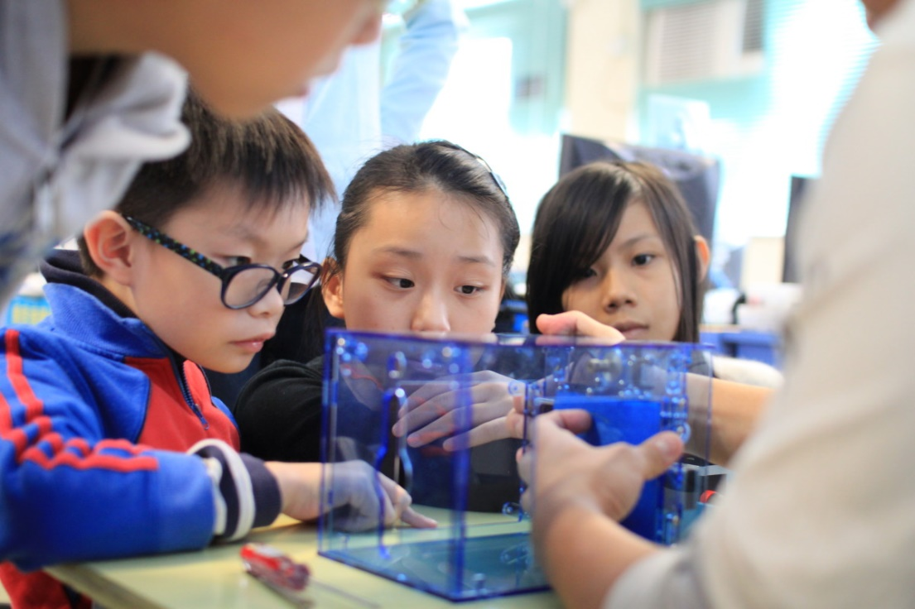
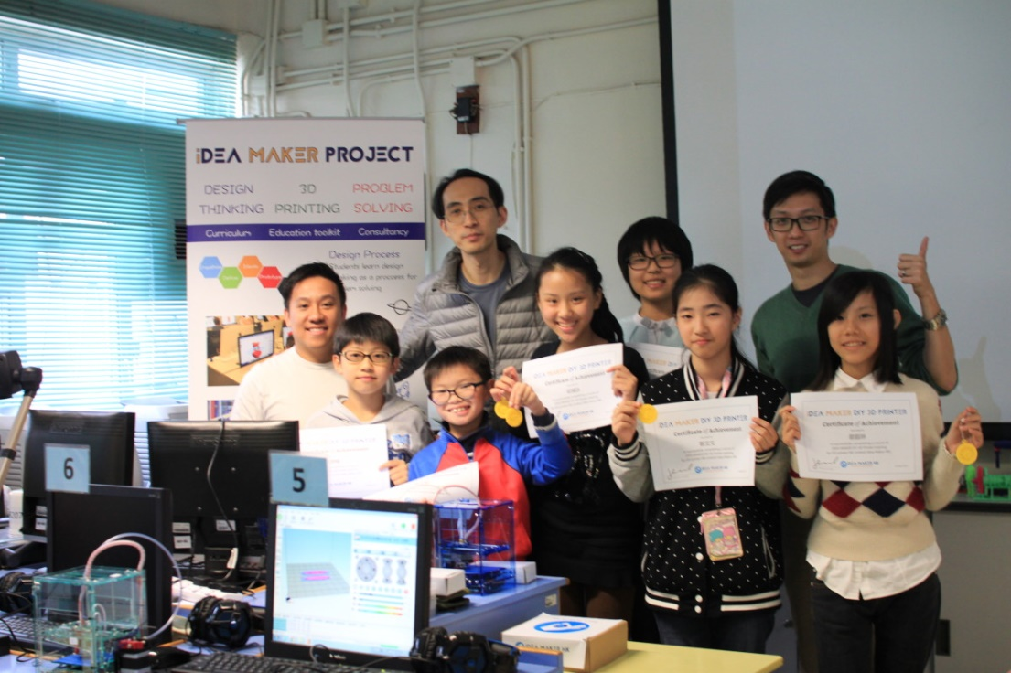

Slide 16
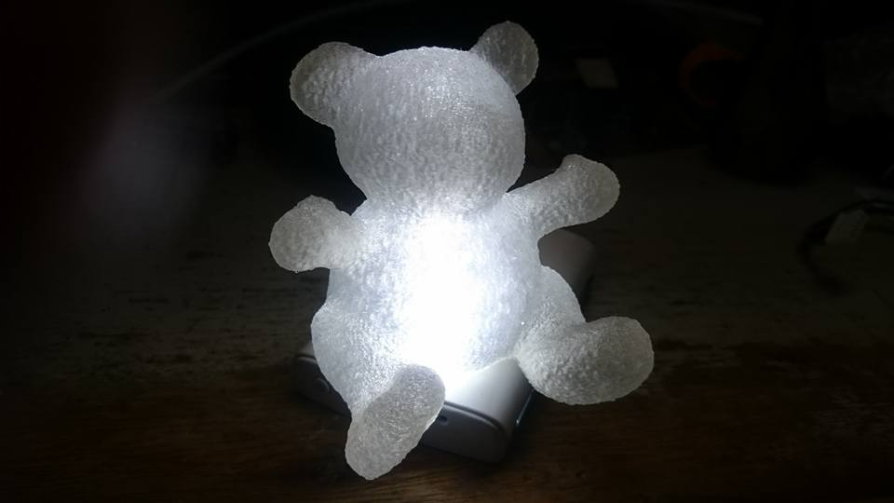
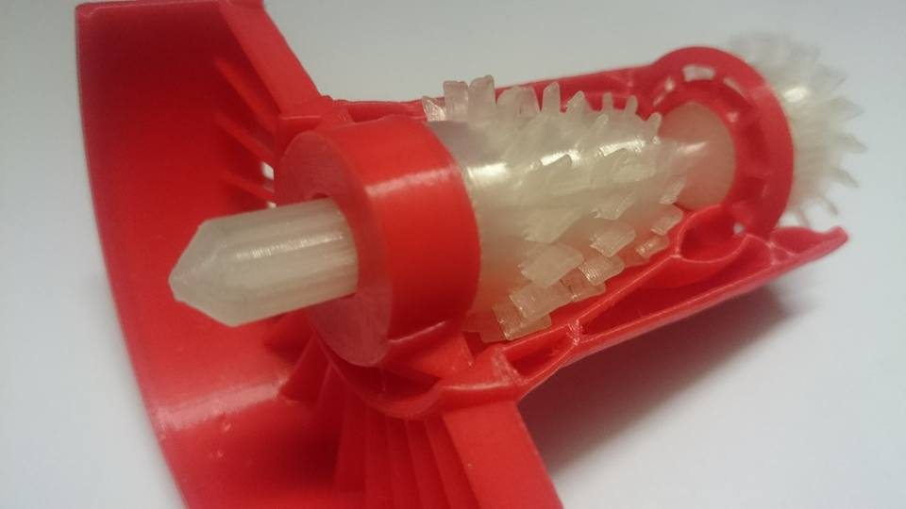
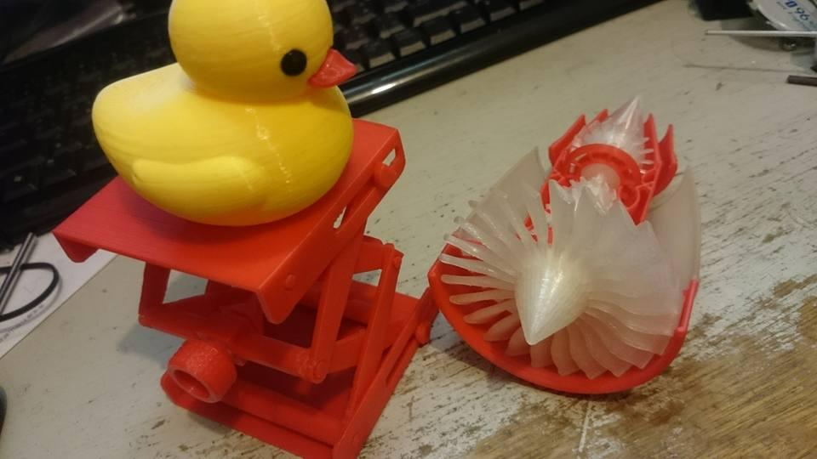
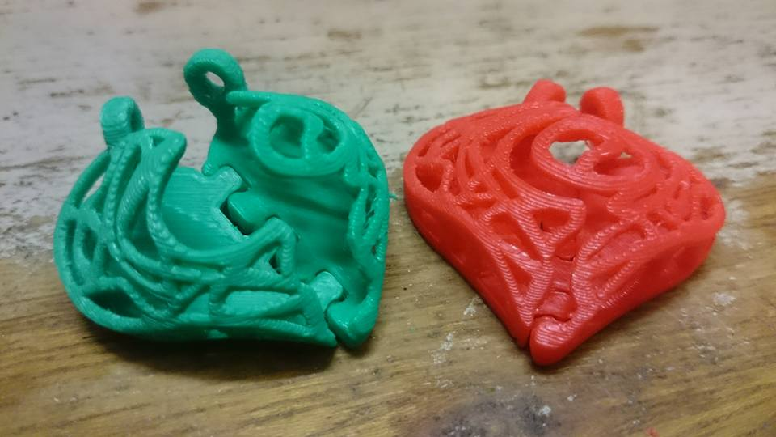
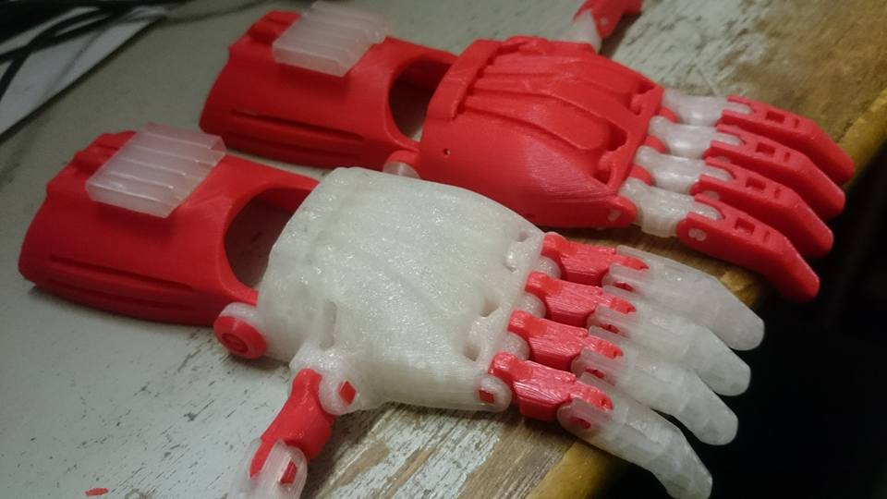

Slide 17
Goal
STEM education pack for each student
3D Printer
Arduino + Sensor Kit
Robotics Kit
Tablet (Win 10 / Android)

Slide 18
Working And Planning
Building teaching materials of STEM for a joint school network with 10 schools currently
Co-operating with NGOs to promote marker movement, opensource idea, open design and creative commons.
To promote STEM / STEAM

Slide 19
Current Services
To create teaching materials and design courses
To prepare Competitions in school or joint schools
Providing formal curriculum, interest groups or elite supporting courses
Conference and Training for Teachers
Consulting on equipment and funding application

Slide 20
Co-operating with (Part of )
Organisation:
HKCOTA
Idea Maker HK
HKMakers.hk
HK Maker Club
HKNGCA Science Innovation Centre
PVCHK
Macau Productivity and Technology Transfer Center
Art:
Seed by Mi
Institution
HKUST (PTC Dept.)
HK Polyu (Sch of Design)
Queen’s College
CMA Secondary School
HKSYC&IA Chan Nam Chong Memorial College
Po Leung Kuk Lo Kit Sing (1983) College
Christian Alliance Cheng Wing Gee College

Slide 21
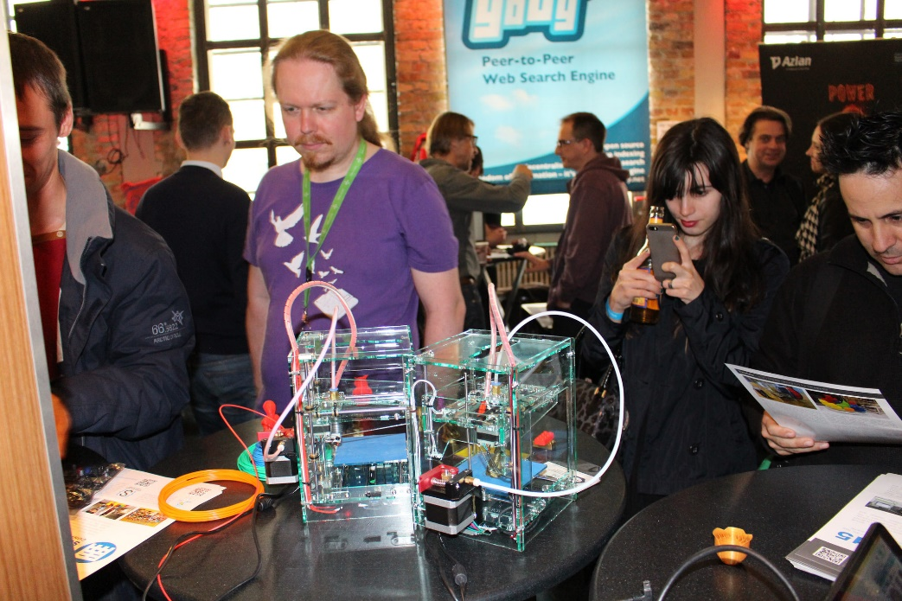
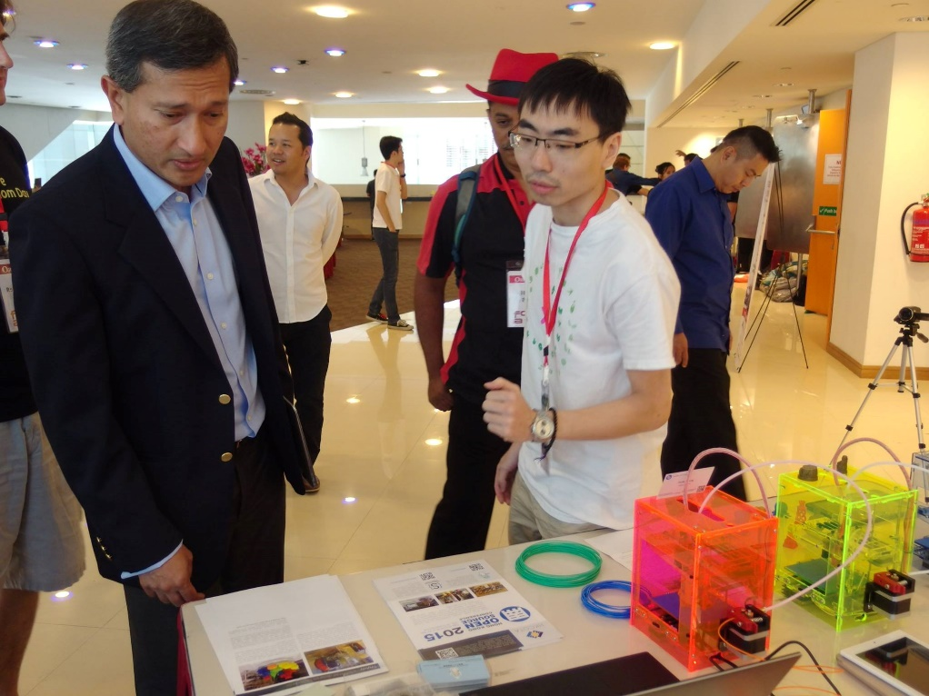
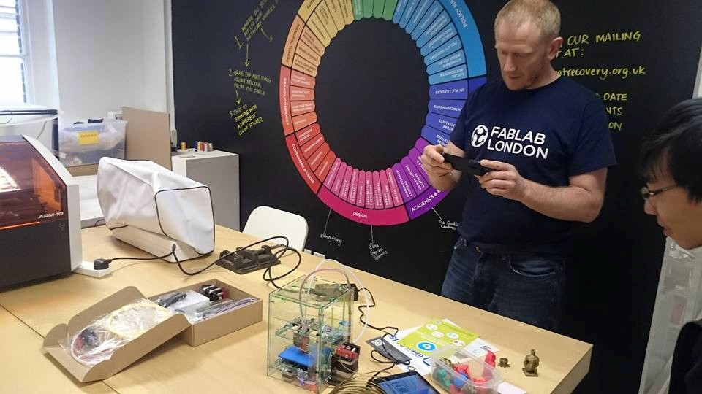

Slide 22
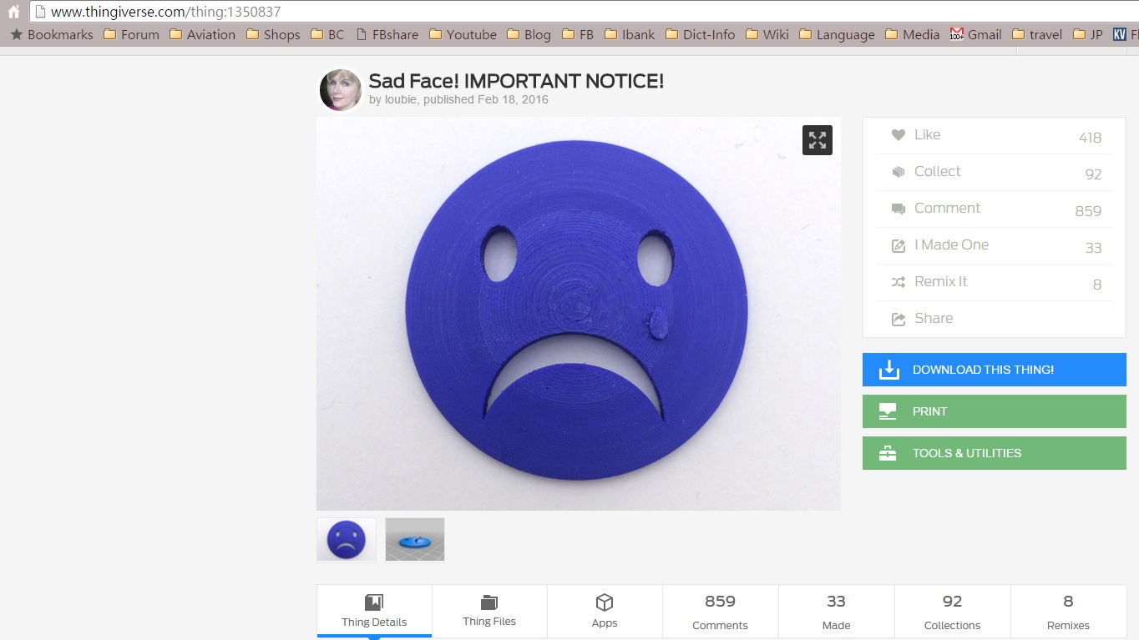
Challenge of open hardware

Slide 23
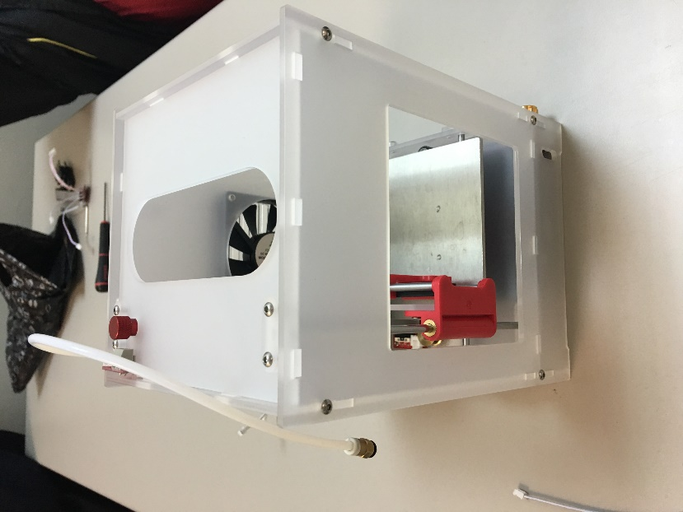
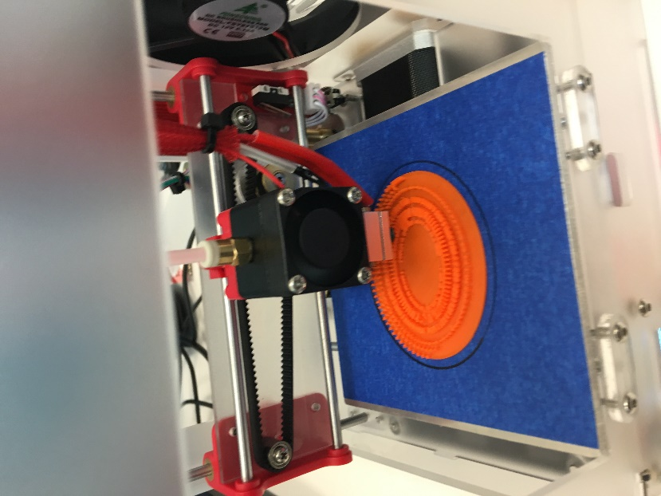
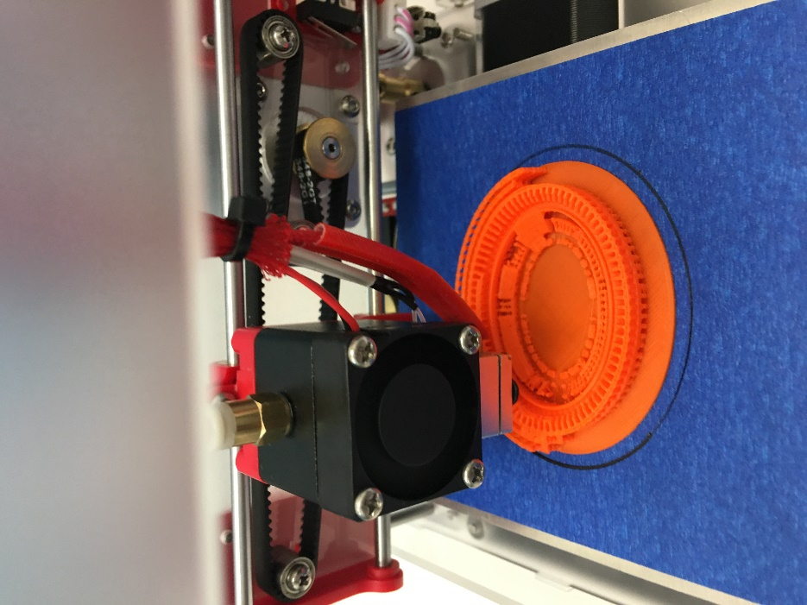
Less positive example

Slide 24
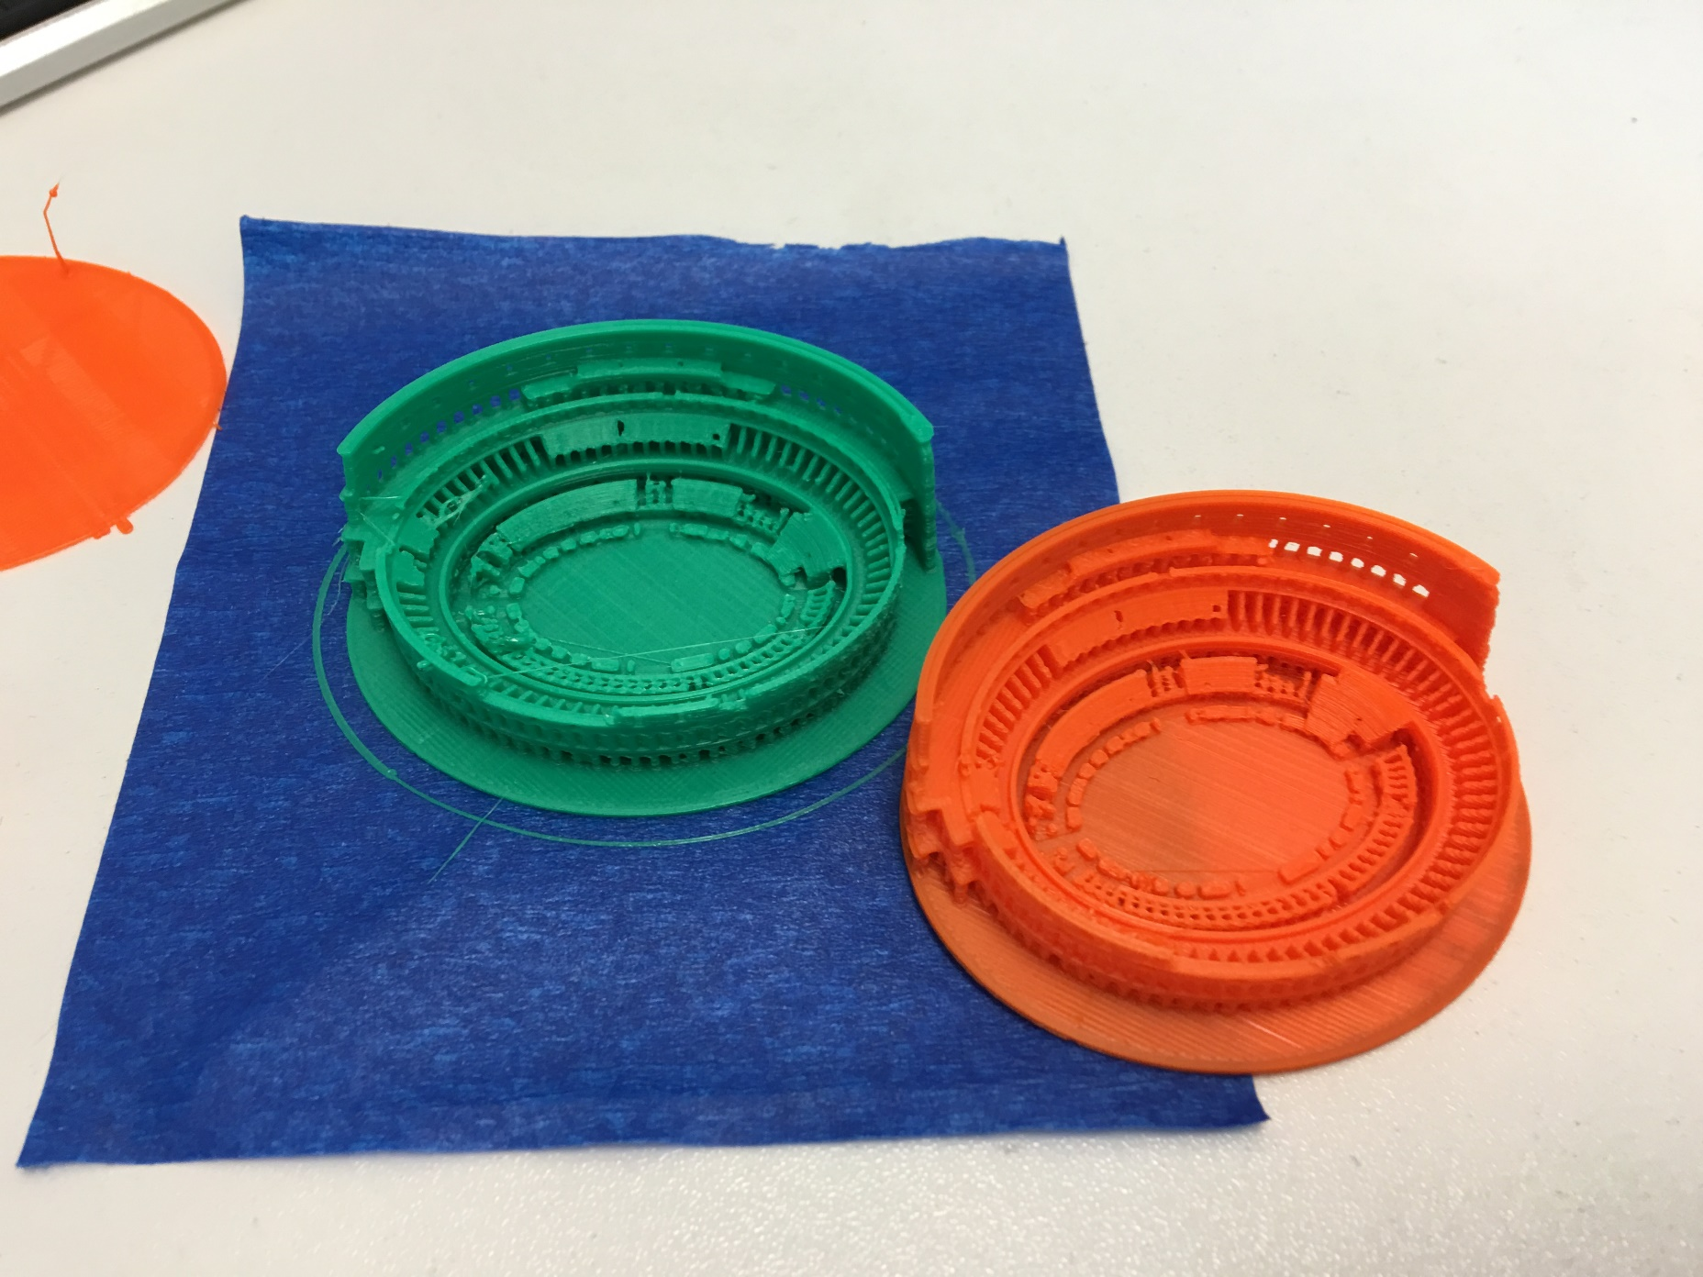

Slide 25
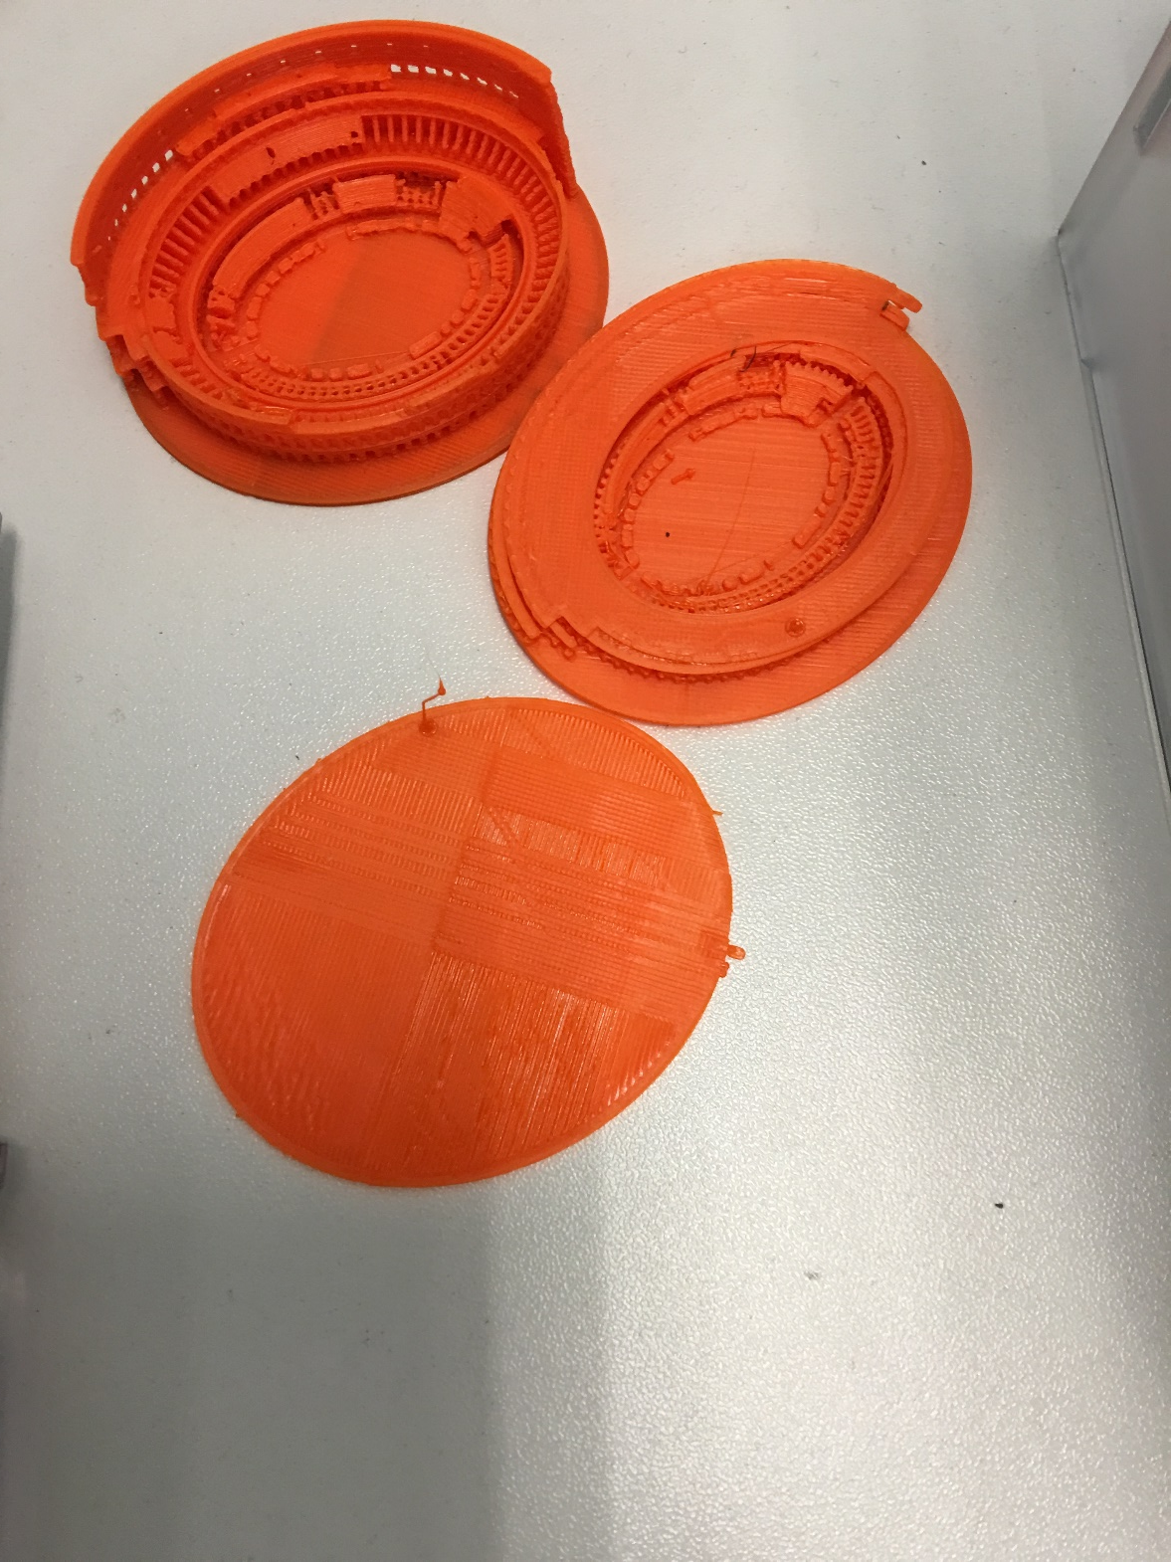

Slide 26
Q and A
Makeomnia

Slide 27
Thanks
Makeomnia

